Slide 1
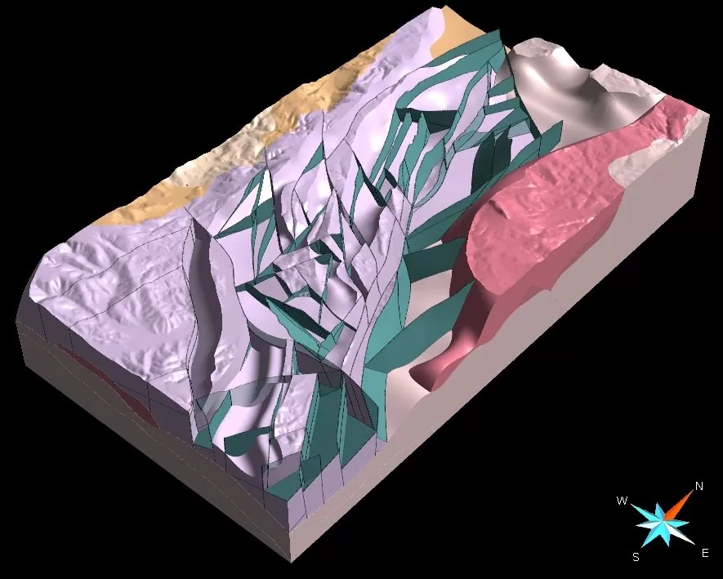
GOCAD Mining Suite – 3D models you can trust
sparse data
integrated geological, geophysical models
advanced structural modelling
implicit and explicit modelling
advanced geostatistics
powerful scripting, macros, workflows
reads and writes GEOH5

Slide 2
GEOH5
documented public, open, easy-to-use, vendor-neutral, permanently accessible data exchange and storage format for the minerals industry
cross-platform, heterogeneous data, fast i/o, compression, big data, keeps metadata with data
readable and writeable by third-party software using scientific programming environments such as HDFview, Python, MATLAB, Fortran, C, and C++
based on free and open-source HDF5 technology
Geoscience ANALYST displays GEOH5 file data in tables, charts, documents, maps, cross-sections, and 3D visualizations

Slide 3
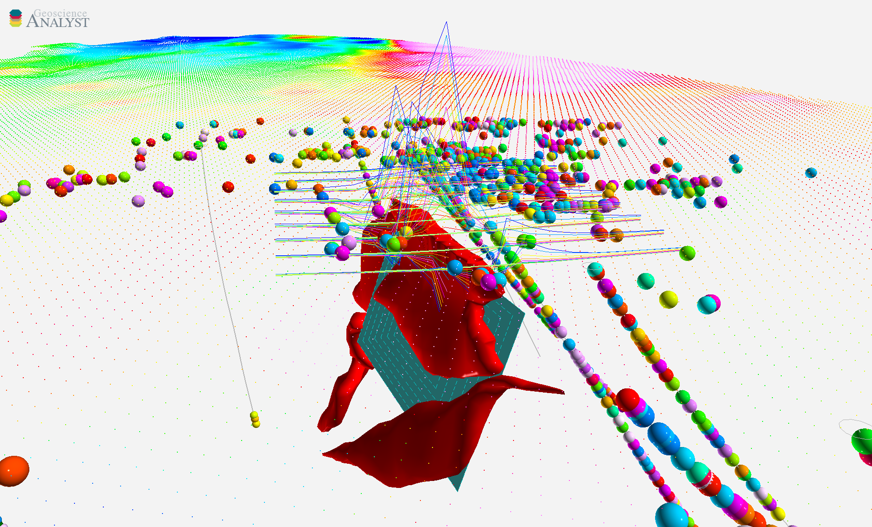
Geoscience ANALYST free viewer
reads and writes GEOH5 files
import, visualize, annotate, save, and distribute 3D geoscientific data, models, and documents/files
multiple linked visualizations, data tables, charts
live connection to the Geoscience INTEGRATOR data management system
Python API
Notes:
More than a simple viewer: Import/compile > visualize/query > edit/annotate > save/share 3D geoscientific data and models to facilitate the use of 3D models in decision making.
Not tied to specific modelling software or restricted to a given file format.
You can also:
Attach files !!!
Comment on objects
Save views with objects
Measure distances

